Slide 1
THE BUZZFEED MARKETING CHALLENGE

Slide 2
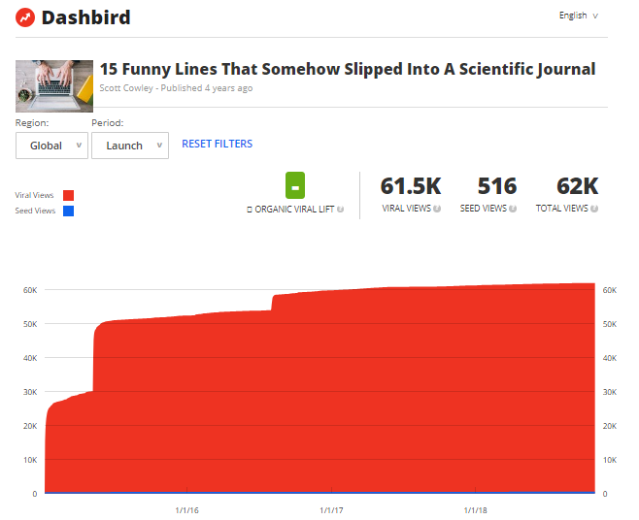
The Goal: 1,000 views in a week
3 ways to do this:
Plan out traffic/promotion sources
Go viral externally
Get promoted by BF

Slide 3
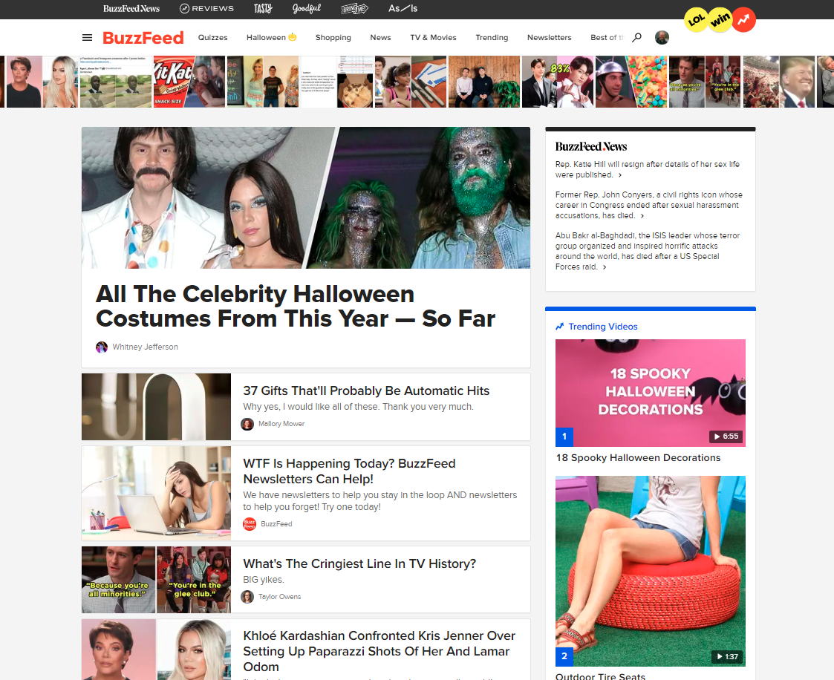

Slide 4
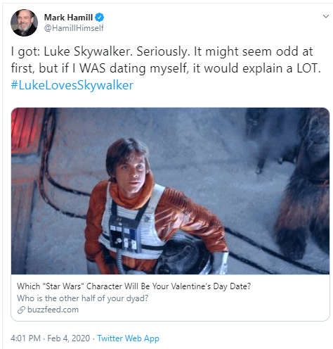
February 2020 – Mark Hamill tweeted about a BuzzFeed quiz he took – created by a student in class

Slide 5
Project Parts
A front-page worthy idea
A promotion list of where to reach your target market
A marketing plan to guide your strategy
The pièce de résistance (your BuzzFeed post)
The campaign
The final case presentation

Slide 6
How to Create Front-page Worthy Content

Slide 7
Every List/Quiz/Poll/Article Needs a Strong Target Market (or two)
What makes the best target market?
Passionate group members
Group members frequently congregate online (forums, groups, fan pages, etc.)
Target market-specific publications and influencers
Target market CANNOT be WMU or students
Content can succeed due to:
Hot Topics (trends/people/media/holidays)
Timeless topics
Group members having better community/influencer access or knowledge

Slide 8
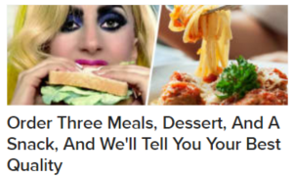
Headlines make a promise (worth clicking) The content has to keep it (worth sharing)

Slide 9
Headlines & Content Need to Drive An Emotion
Remember
Readers should know what emotion to expect from the headline
Make sure the content delivers on the headline’s “emotional promise”
Some types of emotion may drive clicks, but not shares (controversy, cringe, scary)
Positive emotion is generally lower risk

Slide 10
Promotion List (Use the Template)

Slide 11
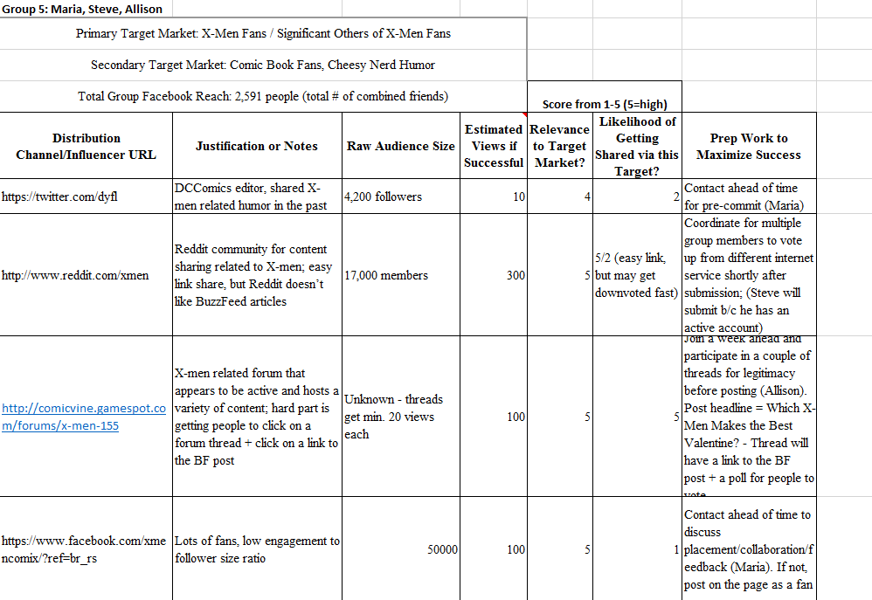

Slide 12
Promotion tips for different channels
BuzzFeed: highly dependent on velocity of traffic/engagement, so you should coordinate this.
Facebook Visibility:
Page posts a link > You sharing a link on the page wall
Sharing in FB groups > Sharing on a fan page wall
Sharing by someone w/ many friends in common > sharing by someone w/ few friends in common
Reddit:
Determine how many votes you need to be visible on the community’s home page (and coordinate how to get those votes)
If you have group members that aren’t active on social media, make them pay their dues in other ways: e-mail outreach, forum participation, etc.

Slide 13
Marketing Plan (Use the Template)

Slide 14
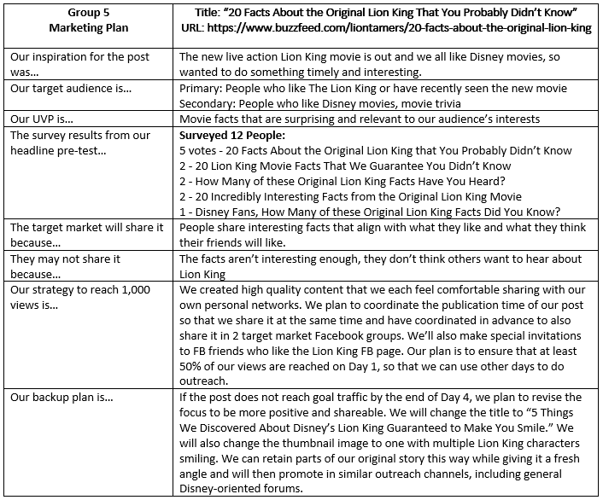

Slide 15
The Post

Slide 16
Publishing in the BuzzFeed Community Section

Slide 17
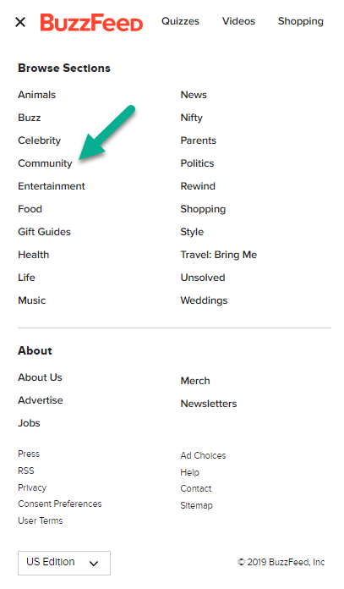
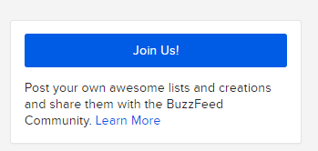
Buzzfeed.com/community
There are sub-sections of BuzzFeed, each with editors/writers listed in the sidebar that you might reach out to for feedback
Fitting squarely within an existing subcategory might help you get promoted within that section first

Slide 18
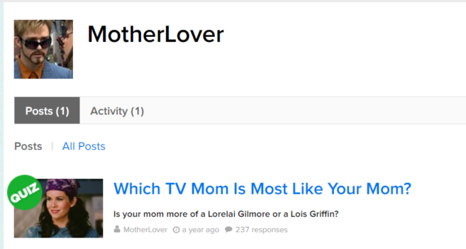
Create a group account using a pseudonym so that all group members can promote it equally as the author

Slide 19
Remember to click “Suggest for community feature” before publishing (This puts the post across the desk of a community editor for consideration)

Slide 20
How do you make a post seem more valuable/relevant/shareable?
Connect with the audience
Use relatable words/terminology for the audience
Signal effort
Longer lists
Customized images
Hook readers immediately
Use your best questions/list items at the very beginning
Finish strong
Make sure that whatever the reader sees at the end is great
Possibly add an engagement question at the end (for lists)
Be unique in your writing and imagery, but have consistency throughout, e.g., consistent tone, formatting
Don’t mix media styles (don’t jump back and forth between images and GIFs)

Slide 21
Using media in your content
Create your own media where it makes sense – a custom thumbnail image that aligns perfectly with your headline
Do not use anything that is copyrighted (especially Getty Images)
Where possible, use “Creative Commons” settings when searching for images
Giphy.com is a go-to source for GIFs
You can use screenshots from YouTube
Always provide link attribution back to the original source
Use Google Reverse Image Search or Tineye.com
Use regular Google Image results as last resort (w/ attribution)

Slide 22
Tips Directly from BuzzFeed
https://www.buzzfeed.com/community/brands
No political or overly commercial content
No attacks on individuals or entities
Tips for making your post:
Use Google Chrome
Make sure you are zoomed into 100%
Make sure all tiles on quizzes are autosized.

Slide 23
The Campaign

Slide 24
Ground Rules
No click-begging or mentioning your assignment, traffic goal, or deadline publicly
You can encourage people to read what you wrote, and take credit for authorship
You can disclose anything you want about the assignment/goal by private channels like e-mail or direct message—evidence of desperation in any of your public promotion will get you penalized
No buying traffic
Don’t spam people (i.e. celebrities) or irrelevant places
Don’t do anything illegal
You may change your headline or content at any time during the promotion period if you think it will help
Grading = ¼ Content, ¼ Reaching the Target Audience, ¼ Marketing & Promo Plans, ¼ Presentation

Slide 25
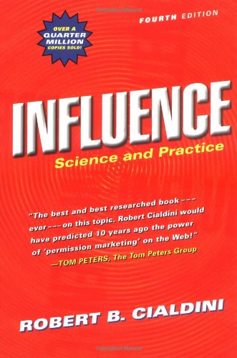
6 Principles of Influence You Can Leverage to Promote Your Content
Liking – People do things for those they like – just ask
Reciprocity – People want to return favors – help others before asking
Consistency – People want to be consistent with what they’ve done in the past (find people who have shared similar content)
Social Proof – People want to jump on the popularity bandwagon
Authority – People follow authority figures
Scarcity – People want to take advantage of something in limited quantity or time availability
Also consider how you can involve others in the making of your content (by including them in planning/feedback, by mentioning them)

Slide 26
Keys To Success
Get feedback from your target market before you publish. Ask whether others would be willing to share it or what it would take to improve the content before sharing.
Make sure you conform with the norms of platforms (content should look natural on BuzzFeed, promotion activity should look natural on the respective other platforms or websites)
Do the legwork to find many different places to promote your content directly to your target market

Slide 27
Last Advice
Desperation leads to poor decisions
Damaging your social capital isn’t worth it
Marketers, not spammers
Remember who you represent
Don’t be the type of group member you hate
Respond to group communication promptly
Be active, identify, and volunteer to do the work your group needs—don’t sit back and wait for somebody else to give you orders

